Slide 1
UML Deployment and Component Diagrams, Designing Persistence Framework with Patterns
Software Design and Analysis
CSCI 2040

Slide 2
Objectives
Summarize UML Deployment and Component notation.
Design a framework with the Template Method, State, and Command patterns.
Introduce issues in object-relational (O-R) mapping.
Implement lazy materialization with Virtual Proxies.

Slide 3
Deployment Diagrams
Deployment Diagrams show the assignment of software artifacts (e.g., executable files) to computational nodes (something with processing services).
It shows the deployment of software elements to the physical architecture
and the communication (usually on a network) between physical elements.
Notes:
What can be a computational node?

Slide 4
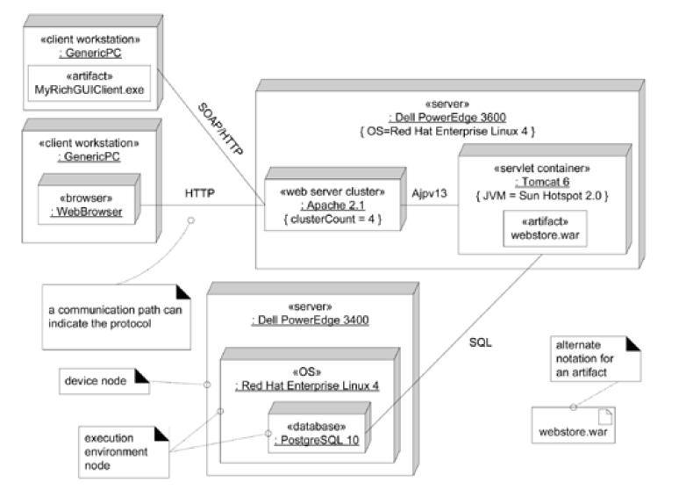
Deployment Diagram

Slide 5
Basis Elements of Deployment Diagrams
The basic element of a deployment diagram is a node, of two types:
device node - physical (e.g., digital electronic) computing resource with processing and memory services to execute software
such as a typical computer or a mobile phone.
execution environment node EEN - this is a software computing resource that runs within an outer node (such as a computer)
and which itself provides a service to host and execute other executable software elements.
Notes:
Which one is device node on the previous diagram?
Example when EEN runs other software elements?

Slide 6
Execution Environment Node Examples
Operating system (OS) is software that hosts and executes programs (e.g., database)
Virtual machine (VM, such as the Java or .NET VM) hosts and executes programs
Database engine (such as PostgreSQL) receives SQL program requests and executes them, and hosts/executes internal stored procedures (written in Java or a proprietary language)
Notes:
Do you know JDBC
CLI

Slide 7
Execution Environment Node Examples
Web browser hosts and executes JavaScript, Java applets, Flash, and other executable technologies
Workflow Engine
Servlet container such as Tomcat
Notes:
Any examples of workflow engines?

Slide 8
Specification
As the UML specification suggests, many node types may show stereotypes
such as «server», «OS», «database», or «browser».
The normal connection between nodes is a communication path, which may be labeled with the protocol.
These usually indicate the network connections.
A node may contain an artifact concrete physical element, usually a file.
This includes executables such as JARs, .exe files, and scripts.
It also includes data files such as XML, HTML, and so forth.
Notes:
execution environment node EEN
Have you heard about XML? What kind of tags would you use: bar, beer, price, …, customer…

Slide 9
Deployment Diagram

Slide 10
Instances
A deployment diagram usually shows an example set of instances (rather than classes).
For example, an instance of a server computer running an instance of the Linux OS.
Generally in the UML, concrete instances are shown with an underline under their name, and the absence of an underline signifies a class rather than an instance.
However, the UML specification states that for Deployment Diagrams, the underlining may be omitted and assumed.
Therefore, you can see examples in both styles.
Notes:
This is a bit confusing. Do you remember how static was denoted? Where was it helpful when it comes to patterns?

Slide 11
Components Diagrams
Components are a slightly fuzzy concept in the UML, because both UML Class Diagram and UML Component Diagram can be used to model the same thing.
UML Class can be used to model any level of software element, from an entire system to subsystem to small utility object.

Slide 12
Component Diagrams Intent
The modeling and design intent is to emphasize
that the interfaces are important, and
it is modular, self-contained and replaceable.
The second point implies that a component tends to have little or no dependency on other external elements
it is a relatively stand-alone module.
Notes:
e.g., database

Slide 13
Design-level Perspective
UML components are a design-level perspective;
they don't exist in the concrete software perspective,
but map to concrete artifacts such as a set of files.
A good analogy for component modeling is a home entertainment system;
we expect to be able to easily replace the DVD player or speakers.
They are modular, self-contained, replaceable, and work via standard interfaces.
Notes:
Do you remember which diagrams are software perspective?
Do not appear in design model, which is software perspective
Unblock US
S. Brin story about PhD

Slide 14
SQL Database Engine and API
For example, at a large-grained level, a SQL database engine can be modeled as a component;
any database that understands the same version of SQL and supports the same transaction semantics can be substituted.
At a finer level, any solution that implements the standard Java Message Service API can be used or replaced in a system.

Slide 15
UML Components

Slide 16
The Problem: Persistent Objects
Assume that in the NextGen application, ProductDescription data resides in a relational database.
It must be brought into local memory during application use.
Persistent objects are those that require persistent storage, such as ProductDescription instances.
Notes:
What is relational database? Do you know any other types of DBs? (graph)
?What are the objects that do not require persistent storage?

Slide 17
Storage Mechanisms and Persistent Objects
Relational databases - Because of the prevalence of RDBs, their use is often required.
Other In addition to RDBs, it is sometimes desirable to store objects in other storage mechanisms or formats, such as flat files, XML structures, graph databases (RDF/SPARQL), and so on.
Notes:
You can ask Guilherme about his project.

Slide 18
Pattern: Representing Objects as Tables
The Representing Objects as Tables pattern proposes defining a table in an RDB for each persistent object class.
Object attributes containing primitive data types (number, string, boolean, and so on) map to columns.

Slide 19
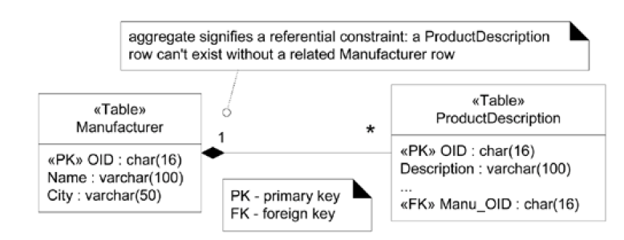
UML Data Modeling Profile
The UML has become a popular notation for data models.
To generalize, the UML has the concept of a UML profile: a coherent set of UML stereotypes, tagged values, and constraints for a particular purpose.
Notes:
Do you remember PK and FK in DBs?
In DB course you will be modelling a database
Area of research: data cleaning

Slide 20
Pattern: Object Identifier
The Object Identifier pattern proposes assigning an object identifier (OID) to each record and object
An OID is usually an alphanumeric value; each is unique to a specific object.
If every object is associated with an OID, and every table has an OID primary key, every object can be uniquely mapped to some row in some table.
Notes:
What identifies person SIN, what identities car VIN

Slide 21
Accessing Persistence Service with Facade
Step one in the design of this subsystem is to define a facade for its services
Facade is a common pattern to provide a unified interface to a subsystem
To begin, an operation is needed to retrieve an object given an OID.
But in addition to an OID, the subsystem needs to know what type of object to materialize;
therefore, the class type will also be provided

Slide 22
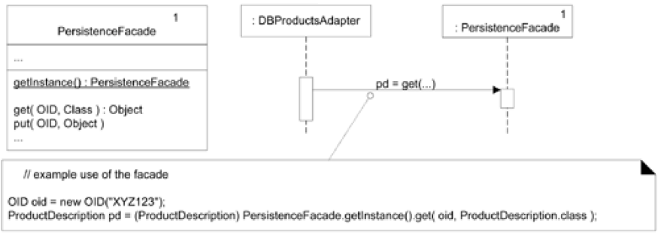
The Persistence Facade
Notes:
Do your remember why getInstance is static? (Factory)

Slide 23
Who should be Responsible for Materialization and Dematerialization of Objects?
The Information Expert pattern suggests that the persistent object class itself (ProductDescription) is a candidate,
because it has some of the data
But if direct mapping is manually added and maintained, it has a number of defects:
Strong coupling of the persistent object class to persistent storage knowledge violation of Low Coupling (and High Cohesion)

Slide 24
Database Mapper (or Database Broker Pattern)
We will explore a classic indirect mapping approach, that uses other objects to do the mapping for persistent objects.
Part of this approach is to use the Database Broker pattern.
It proposes making a class that is responsible for materialization, dematerialization, and object caching.
This has also been called the Database Mapper pattern.
A different mapper class is defined for each persistent object class.

Slide 25
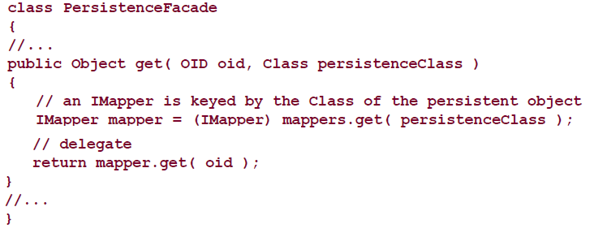
Snippet of Code
Each persistent object may have its own mapper class,
and there may be different kinds of mappers for different storage mechanisms (see next slide).
Notes:
What does persistence class represent?

Slide 26
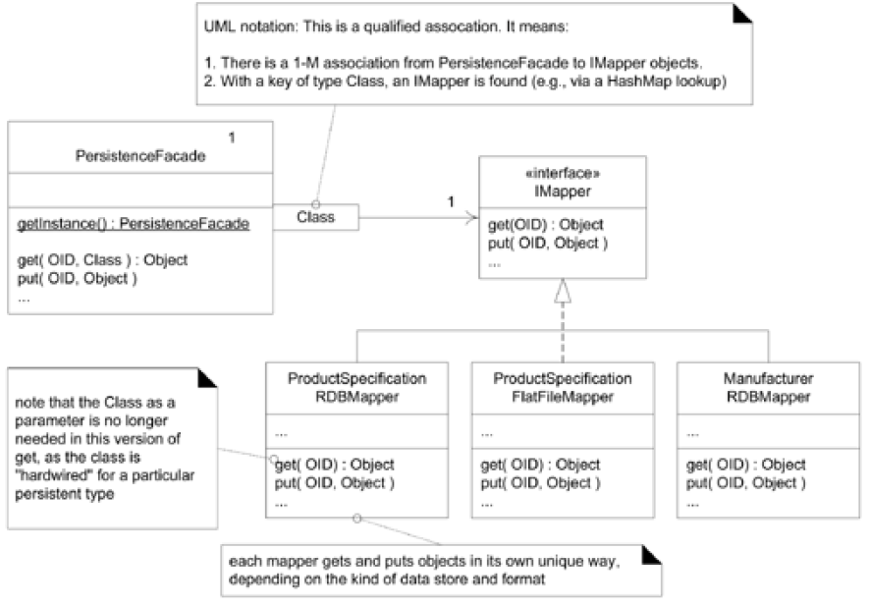
Database Mappers
Notes:
Do you remember qualified association?
Data Integration?
Although this diagram indicates two ProductDescription mappers, only one will be active within a
running persistence service.

Slide 27
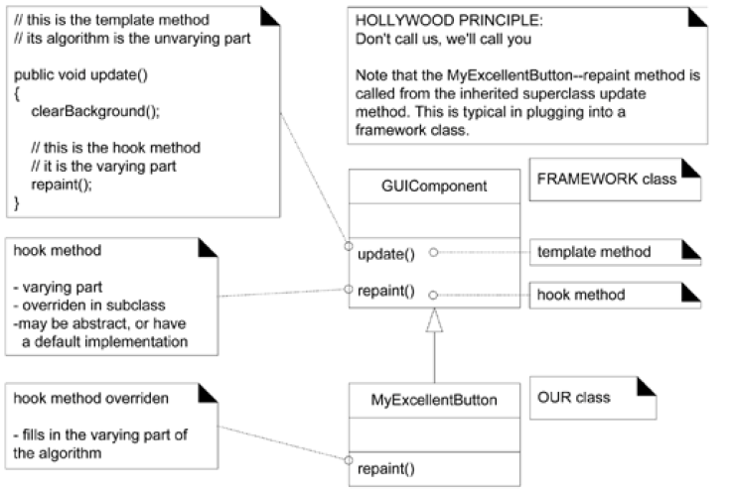
Template Method
The idea is to define the Template Method in a superclass that defines the skeleton of an algorithm, with its varying and unvarying parts.

Slide 28
Materialization with the Template Method Pattern
If we were to program two or three mapper classes, some commonality in the code would become apparent.
The basic repeating algorithm structure for materializing an object is:
The point of variation is how the object is created from storage.

Slide 29
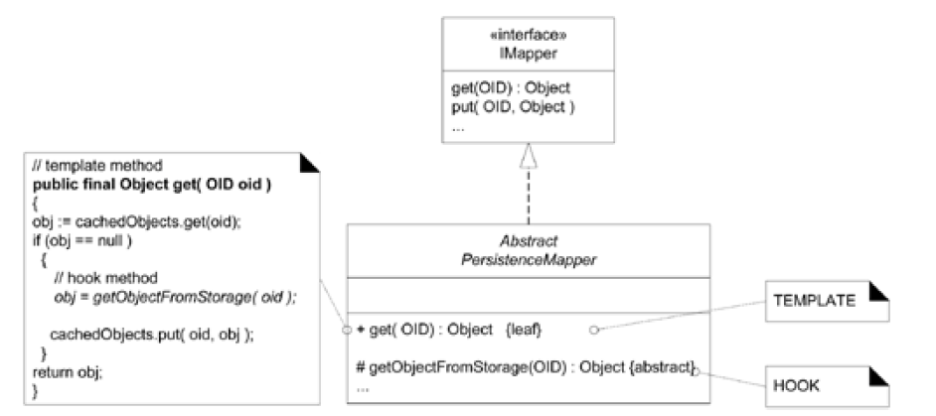
Template Method for Mapper Objects

Slide 30
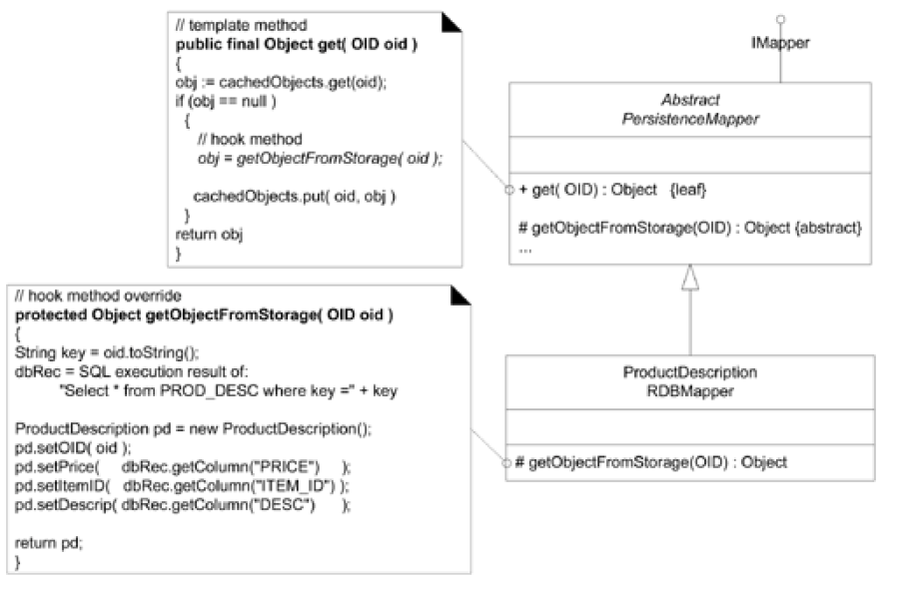
Overriding the Hook Method

Slide 31
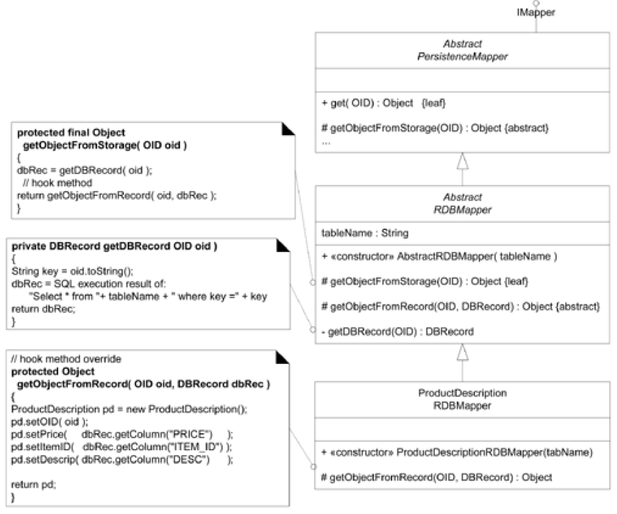
Tightening up the Code with Template Method
Notes:
We can have XML, GraphDB mapper etc.

Slide 32
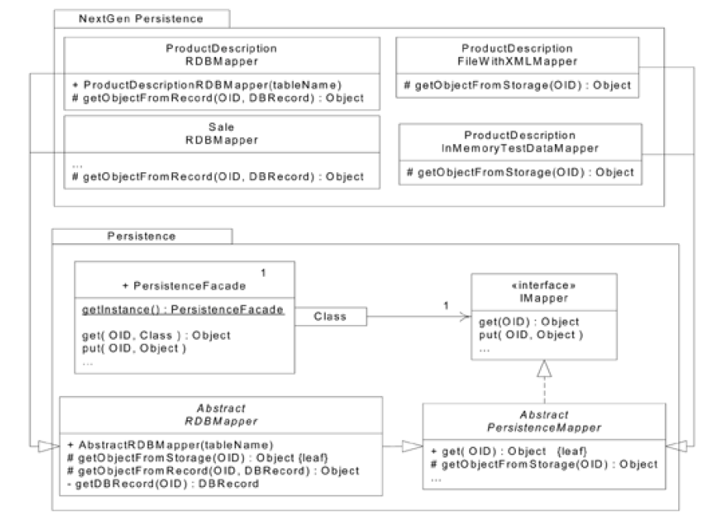
The Persistence Framework
Notes:
We use Template Method

Slide 33
Consolidating and Hiding SQL Statements in One Class
There is a single Pure Fabrication class (and it's a singleton) RDBOperations where all SQL operations (SELECT, INSERT, ...) are consolidated.
The RDB mapper classes collaborate with it to obtain a DB record or record set (for example, ResultSet). Its interface looks something like this:

Slide 34
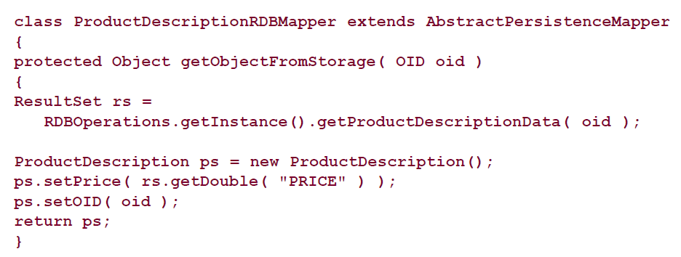
Mapper Code
So that, for example, a mapper has code like this:

Slide 35
Mapper Code
The following are benefits from this Pure Fabrication:
Ease of maintenance and performance tuning by an expert.
SQL optimization requires a SQL aficionado, rather than an object programmer.
With all the SQL embedded in this one class, it is easy for the SQL expert to find and work on it.
Encapsulation of the access method and details.
For example, hard-coded SQL could be replaced by a call to a stored procedure in the RDB in order to obtain the data.

Slide 36
Transactional States and the State Pattern
Persistent objects can be inserted, deleted, or modified.
Operating on a persistent object (for example, modifying it) does not cause an immediate database update;
rather, an explicit commit operation must be performed.
For example, an "old dirty" object is retrieved from the database and modified.
On a commit operation, it should be updated to the database in contrast to one in the "old clean" state, which should do nothing (because it hasn't changed).
When a delete or save operation is performed, it does not immediately cause a database delete or save; rather, the persistent object transitions to the appropriate state, awaiting a commit or rollback to really do something.
Notes:
Have you heard about commit and rollback operations?

Slide 37
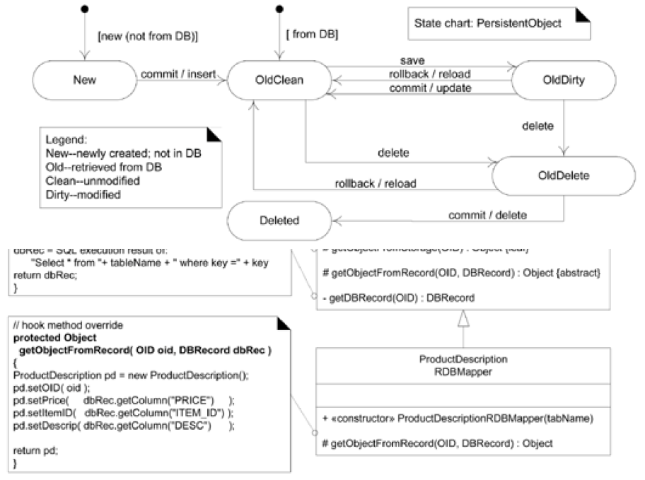
State Chart for Persistent Object
Notes:
Do you remember state chart?
UPDATE (save)
DELETE (delete)

Slide 38
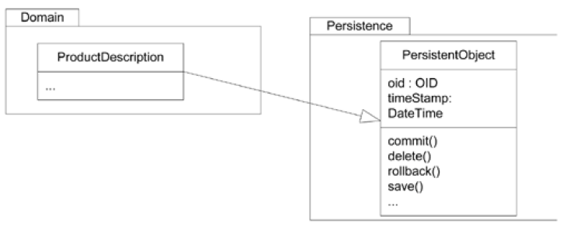
Persistent Objects
In this design, assume that we will make all persistent object classes extend a PersistentObject class that provides common technical services for persistence.

Slide 39
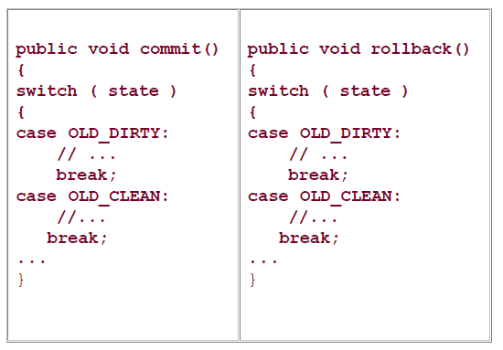
Similar Structure of Case Logic
Notice that commit and rollback methods require similar structures of case logic, based on a transactional state code.
commit and rollback perform different actions in their cases, but they have similar logic structures.

Slide 40
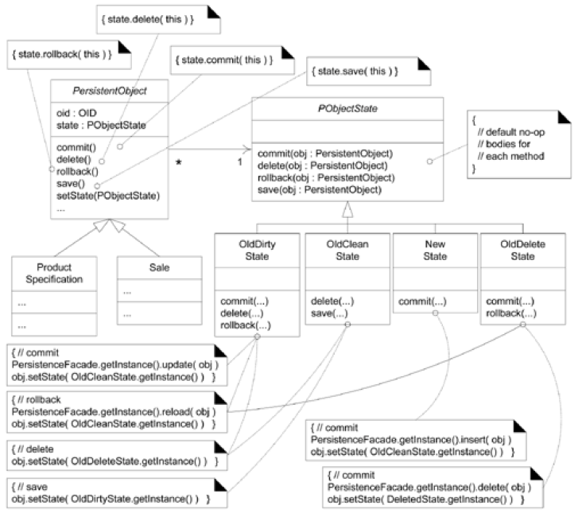
Applying the State Pattern
An alternative to this repeating case logic structure is the GoF State pattern.

Slide 41
Designing Transaction with the Commend Pattern
Transaction is a unit of work a set of tasks whose tasks must all complete successfully, or none must be completed. That is, its completion is atomic.
In terms of the persistence service, the tasks of a transaction include inserting, updating, and deleting objects. One transaction could contain two inserts, one update, and three deletes, for example.
Command Pattern: Make each task a class that implements a common interface.
Notes:
Joe
J1 Ins 3 3.5
J2 Del 3 3.5 Ins 2.5
Sue S1 Min S2 Max
J1 S1 J2 S2
T1: J1, J2, T2 S1 S2

Slide 42
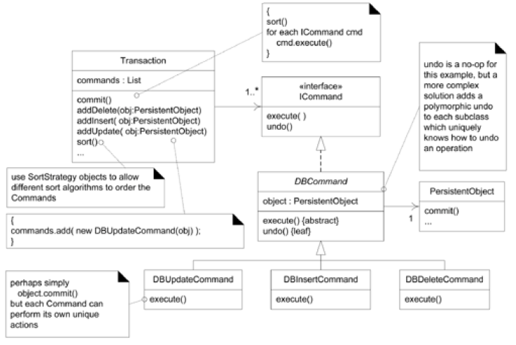
Commands for Database Operations

Slide 43
Quiz
What is the difference between Component and Package Diagrams?
Describe Database Broker Pattern
What is a transaction in databases
What is the pattern used for transations?

Slide 44
Actions
Review Slides.
Read Chapter 37 and Chapter 38
UML Deployment and Component Diagrams, Designing a Persistence Framework with Patterns; Applying UML and Patterns, Craig Larman

